Slide 1

Module 6: Populating a Custom Set of Date Dimension Values
0/5
Analytics: Advanced Data Warehouse Developer
Notes:
Time: Lecture: 15 – 20 minutes; Labs: 30 – 40 minutes
Intent: To learn to configure and populate a custom set of date dimension values
Flow: Describe the date dimension; define the ETL parameters used to build the date dimension; review things to consider before customizing the analysis start and end dates to populate the date dimension
Key Terms:
Date Dimension
Analysis Start Date
Analysis End Date
Fiscal Dates
DAC Client
Informatica
Database Parameter File
6

Slide 2
Module Objectives
After completing this module you will be able to:
  Configure the extraction, transformation, and loading (ETL) parameters used to build the date dimension in the Siebel Relationship Management Warehouse (SRMW)
  Populate a custom set of date dimension values in the SRMW using Informatica and the Data Warehouse Application Console (DAC)
Why you need to know:
  Allows you to expand the range of start and end date analysis of facts in the SRMW
Notes:
Each objective and “why you need to know” should be stated aloud.

Slide 3
Date Dimension
Is one of the most important dimensions in the SRMW
Represents the date and contains one row for each day
Contains a wide range of date attributes
Includes fiscal date values to a support broad range of fact analysis by customer’s fiscal dates
  For example, FSCL_MONTH, FSCL_QTR, and FSCL_YEAR
Is populated in advance with 30 years worth of data about the date
Notes:
This slide describes the out-of-the-box Date dimension in the SRMW.
6

Slide 4
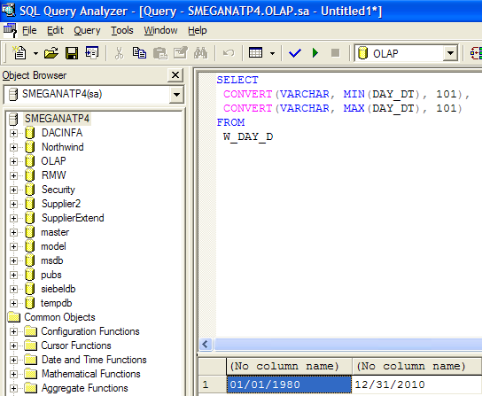
Date Dimension Continued
W_DAY_D is the date dimension table in the SRMW
Populated during the full ETL load
  Is not updated during the incremental ETL load
Table Name
The start and end dates correspond to 30 years worth of data
Notes:
The W_DAY_D table contains columns for creating time comparison measures. The columns that support time comparison measures include DAY_AGO_WID, WEEK_AGO_WID, MONTH_AGO_WID, QUARTER_AGO_WID, HALF_AGO_WID, and YEAR_AGO_WID.

Slide 5
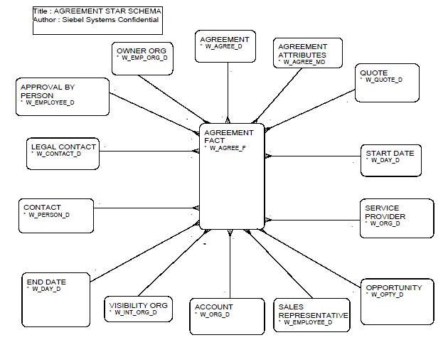
Star Schema with Date Dimension: Example
The Start Date and End Date dimension tables of the Agreement Fact star schema are based on the date dimension in the SRMW
  Start Date and End Date are alias tables based on the W_DAY_D table
Notes:
Every star schema in the SRMW contains one or more date dimension tables based on the W_DAY_D physical table.
6

Slide 6
ETL Parameters
Are used to build the date dimension table in the SRMW
Define start and end date range to populate date dimension
  Analysis Start Date – The default value is Jan 1, 1980
  Analysis End Date – The default value is Dec 31, 2010
Are customized to load a custom set of date dimension values with a different start and end date range
Notes:
This slide describe the ETL parameters used to build the date dimension in the SRMW.

Slide 7
Configuring ETL Parameters
0/2
Configure the ETL parameters using:
  DAC Client
  Informatica Parameter File
Notes:
This is a structuring slide. Do not teach the steps or concepts here because the following slides cover them in detail.
6

Slide 8
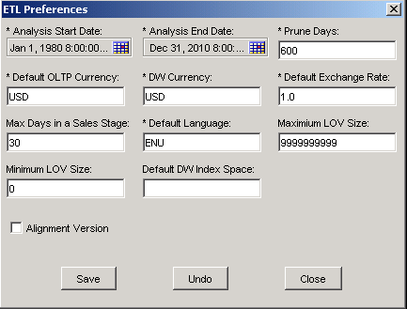
1. DAC Client
1/2
Use the DAC client to configure analysis start and end dates
  Navigate to Tools > ETL Management > Preferences
The start date used to build the date dimension
The end date used to build the date dimension
Notes:
This slide details the steps to configure the ETL parameters in the DAC client.

Slide 9
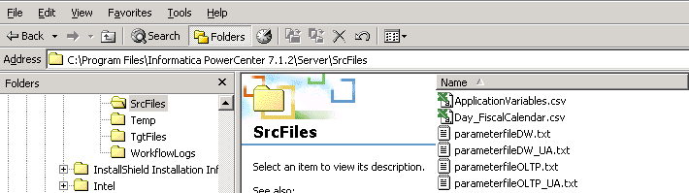
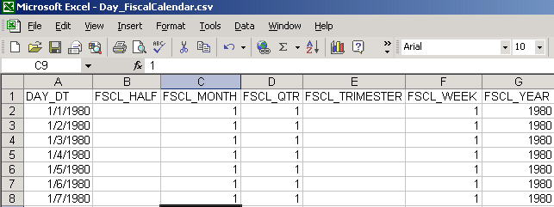
2. Informatica Parameter File
2/2
Configure the Day_FiscalCalendar.csv file to include fiscal date column values for expanded analysis start and end dates
  The SIL_DayDimension mapping loads the fiscal date column values stored in the Day_FiscalCalendar.csv file when populating the date dimension table
The as-delivered file contains fiscal date column values for dates ranging from 01/01/1980 to 12/31/2010
Fiscal date columns
Notes:
This slide details the steps to configure the ETL parameters in the Informatica.
6

Slide 10
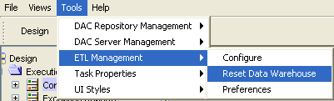
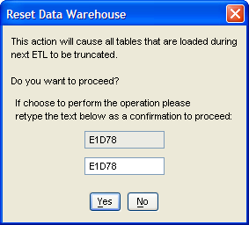
Reset the SRMW
Use the DAC to reset the data warehouse before loading the expanded set of date dimension values
  Resetting the data warehouse triggers the full ETL load
Notes:
Resetting the SRMW truncates data from all the tables in the SRMW. Therefore, care should be taken before resetting the SRMW.

Slide 11
Considerations
A full ETL load needs to be performed after the configuration
  W_DAY_D table is not updated during the incremental ETL load
The data warehouse needs to be reset to perform the full ETL load
The new expanded start and end dates should be the superset of previous date range in the SRMW
  Decreasing the analysis start or end date can make the existing facts useless
Notes:
This slide lists some additional considerations of expanding the start and end date ranges in the SRMW.
6

Slide 12
Summary
This module showed you how to:
  Configure the extraction, transformation, and loading (ETL) parameters used to build the date dimension in the Siebel Relationship Management Warehouse (SRMW)
  Populate a custom set of date dimension values in the SRMW using Informatica and the Data Warehouse Application Console (DAC)
Notes:
This slide presents a summary of the topics covered in the module.

Slide 13
Lab
In the lab you will:
  Perform steps to expand the range of analysis start and end dates of facts in the SRMW
  Perform steps to populate a custom set of date dimension values
Notes:
Labs and Troubleshooting:
In this lab, students are asked to customize the ETL process to populate the date dimension table with 40 years worth of data about days.
6

